Slide 1
Stepping Stone Method

Slide 2
Stepping Stone Method Steps (Rule)
Step-1: | Find an initial basic feasible solution using any one of the three methods NWCM, LCM or VAM.
Step-2: | 1. Draw a closed path (or loop) from an unoccupied cell. The right angle turn in this path is allowed only at occupied cells and at the original unoccupied cell. Mark (+) and (-) sign alternatively at each corner, starting from the original unoccupied cell. 2. Add the transportation costs of each cell traced in the closed path. This is called net cost change. 3. Repeat this for all other unoccupied cells.
Step-3: | 1. If all the net cost change are ≥0, an optimal solution has been reached. Now stop this procedure. 2. If not then select the unoccupied cell having the highest negative net cost change and draw a closed path.
Step-4: | 1. Select minimum allocated value among all negative position (-) on closed path 2. Assign this value to selected unoccupied cell (So unoccupied cell becomes occupied cell). 3. Add this value to the other occupied cells marked with (+) sign. 4. Subtract this value to the other occupied cells marked with (-) sign.
Step-5: | Repeat Step-2 to step-4 until optimal solution is obtained. This procedure stops when all net cost change ≥0 for unoccupied cells.

Slide 3
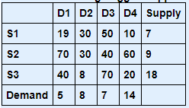
Example-1 Find Solution using Vogel's Approximation method, also find optimal solution using stepping stone method

Slide 4
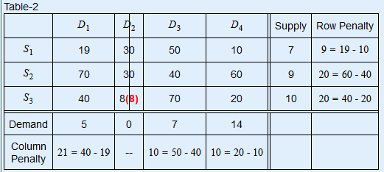
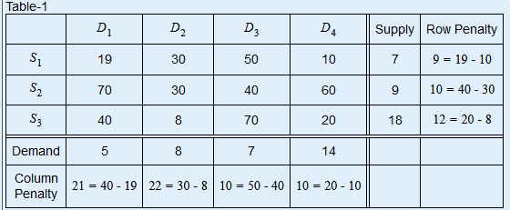
Solution: TOTAL number of supply constraints : 3 TOTAL number of demand constraints : 4 Problem Table is
The maximum penalty, 22, occurs in column D2. The minimum cij in this column is c32 = 8. The maximum allocation in this cell is min(18,8) = 8. It satisfy demand of D2 and adjust the supply of S3 from 18 to 10 (18 - 8 = 10).

Slide 5
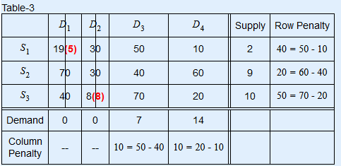
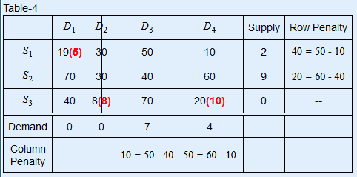
The maximum penalty, 21, occurs in column D1. The minimum cij in this column is c11 = 19. The maximum allocation in this cell is min(7,5) = 5. It satisfy demand of D1 and adjust the supply of S1 from 7 to 2 (7 - 5 = 2).
The maximum penalty, 50, occurs in row S3. The minimum cij in this row is c34 = 20. The maximum allocation in this cell is min(10,14) = 10. It satisfy supply of S3 and adjust the demand of D4 from 14 to 4 (14 - 10 = 4).

Slide 6
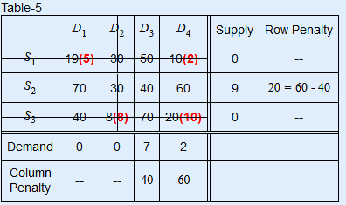
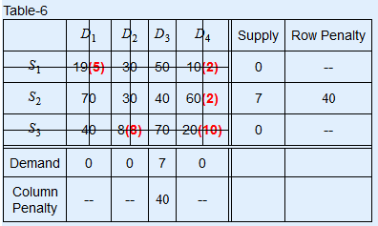
The maximum penalty, 50, occurs in column D4. The minimum cij in this column is c14 = 10. The maximum allocation in this cell is min(2,4) = 2. It satisfy supply of S1 and adjust the demand of D4 from 4 to 2 (4 - 2 = 2).
The maximum penalty, 60, occurs in column D4. The minimum cij in this column is c24 = 60. The maximum allocation in this cell is min(9,2) = 2. It satisfy demand of D4 and adjust the supply of S2 from 9 to 7 (9 - 2 = 7).

Slide 7
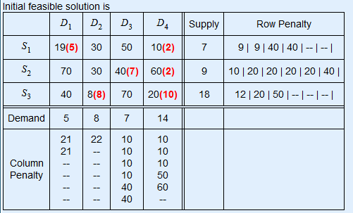

The maximum penalty, 40, occurs in row S2. The minimum cij in this row is c23 = 40. The maximum allocation in this cell is min(7,7) = 7. It satisfy supply of S2 and demand of D3.

Slide 8

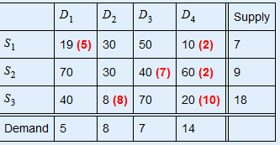
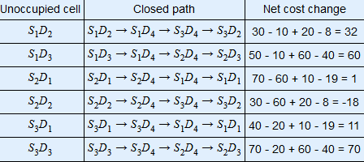
Iteration-1 of optimality test 1. Create closed loop for unoccupied cells, we get
Optimality test using
stepping stone method...
Allocation Table is
2. Select the unoccupied cell having the highest negative net cost change i.e. cell S2D2=-18.
and draw a closed path from S2D2.
Closed path is S2D2→S2D4→S3D4→S3D2​
Closed path and plus/minus allocation for current unoccupied cell S2D2

Slide 9
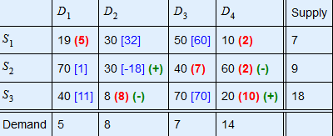
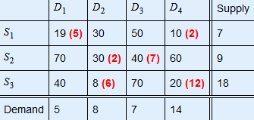
2. Select the unoccupied cell having the highest negative net cost change i.e. cell S2D2=-18. and draw a closed path from S2D2. Closed path is S2D2→S2D4→S3D4→S3D2 Closed path and plus/minus allocation for current unoccupied cell S2D2
3. Minimum allocated value among all negative position (-) on closed path = 2
Substract 2 from all (-) and Add it to all (+)

Slide 10
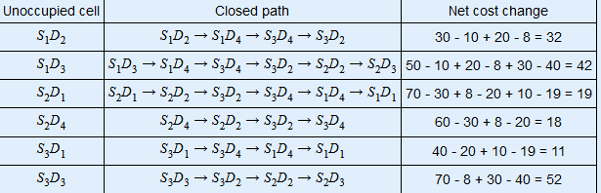
4. Repeat the step 1 to 3, until an optimal solution is obtained.
Iteration-2 of optimality test 1. Create closed loop for unoccupied cells, we get

Slide 11
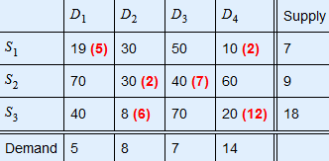
Since all net cost change ≥0 So final optimal solution is arrived.
The minimum total transportation cost =19×5+10×2+30×2+40×7+8×6+20×12=743
Ref: https://cbom.atozmath.com/example/CBOM/Transportation.aspx?he=e&q=ss​

Slide 12
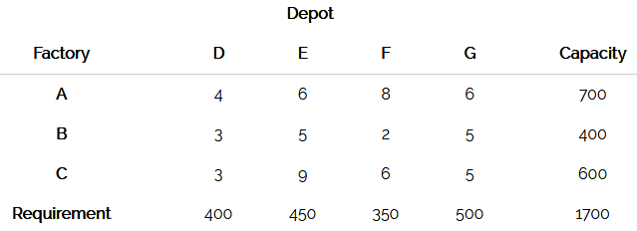
Example 1: Stepping Stone Method
A company has three factories A, B, and C with production capacity 700, 400, and 600 units per week respectively. These units are to be shipped to four depots D, E, F, and G with requirement of 400, 450, 350, and 500 units per week respectively. The transportation costs (in Rs.) per unit between factories and depots are given below:
The decision problem is to minimize the total transportation cost for all factory-depot shipping patterns.

Slide 13
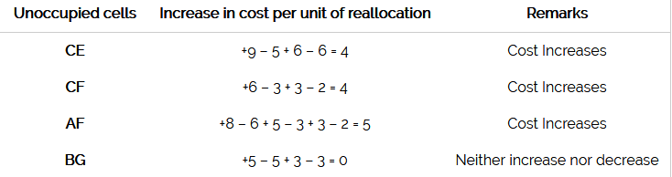
Solution.
An initial basic feasible solution is obtained by Matrix Minimum Method and is shown below in table 1.
Here, m + n - 1 = 6. So the solution is not degenerate.
Initial basic feasible solution
6 X 450 + 6 X 250 + 3 X 50 + 2 X 350 + 3 X 350 + 5 X 250 = 7350
Since all the values of unoccupied cells are greater than or equal to zero, the solution obtained is optimal.
Minimum transportation cost is:
6 X 450 + 6 X 250 + 3 X 50 + 2 X 350 + 3 X 350 + 5 X 250 = Rs. 7350
Ref: http://www.universalteacherpublications.com/univ/ebooks/or/Ch5/stepst.htm

